Slide 1
CHAPTER 9
CUSTOMER RELATIONSHIP MANAGEMENT

Slide 2
Learning outcomes
Outline different methods of acquiring customers via electronic media
Evaluate different buyer behaviour amongst online customers
Describe techniques for retaining customers and cross-and up-selling using new media.

Slide 3
Management issues
What is the balance between online and offline investment for customer acquisition?
What technologies can be used to build and maintain the online relationship?
How do we deliver superior service quality to build and maintain relationships?

Slide 4
What is CRM?
An approach to building and sustaining long-term business with customers
CRM comprises of four marketing activities:
  Customer selection
  Customer acquisition
  Customer retention
  Customer extension

Slide 5
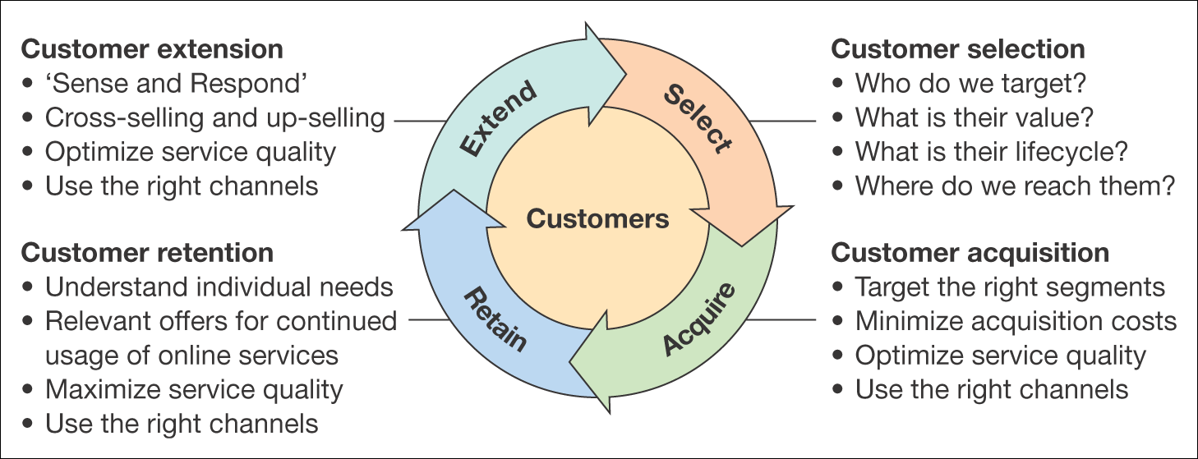
Figure 9.1 The four classic marketing activities of customer relationship management

Slide 6
Marketing applications of CRM
A CRM system supports the following marketing applications:
Sales force automation (SFA). Sales representatives are supported in their account management through tools to arrange and record customer visits.
Customer service management. Representatives in contact centres respond to customer requests for information by using an intranet to access databases containing information on the customer, products and previous queries.
Managing the sales process. This can be achieved through e-commerce sites, or in a B2B context by supporting sales representatives by recording the sales process (SFA).
Campaign management. Managing ad, direct mail, e-mail and other campaigns.
Analysis. Through technologies such as data warehouses and approaches such as data mining, which are explained later in the chapter, customers’ characteristics, their purchase behaviour and campaigns can be analysed in order to optimize the marketing mix.

Slide 7
E-CRM – a definition
E-CRM is:
Applying –
Internet and other digital technology…
(web, e-mail, wireless, iTV, databases)
To –
acquire and retain customers
(through a multi-channel buying process
and customer lifecycle)
By –
Improving customer knowledge, targeting,
service delivery and satisfaction.

Slide 8
Benefits of e-CRM
Targeting more cost-effectively
Achieve mass customization of the marketing messages
Increase depth, breadth and nature of relationship
A learning relationship can be achieved
Lower cost

Slide 9
Permission marketing
Customers agree to be involved in an organization’s marketing activities, usually as a result of an incentive
Godin (1999) suggests that dating the customer involves:
  Offering the prospect an incentive
  Using the attention to teach
  Reinforce the incentive
  Offer additional incentive

Slide 10
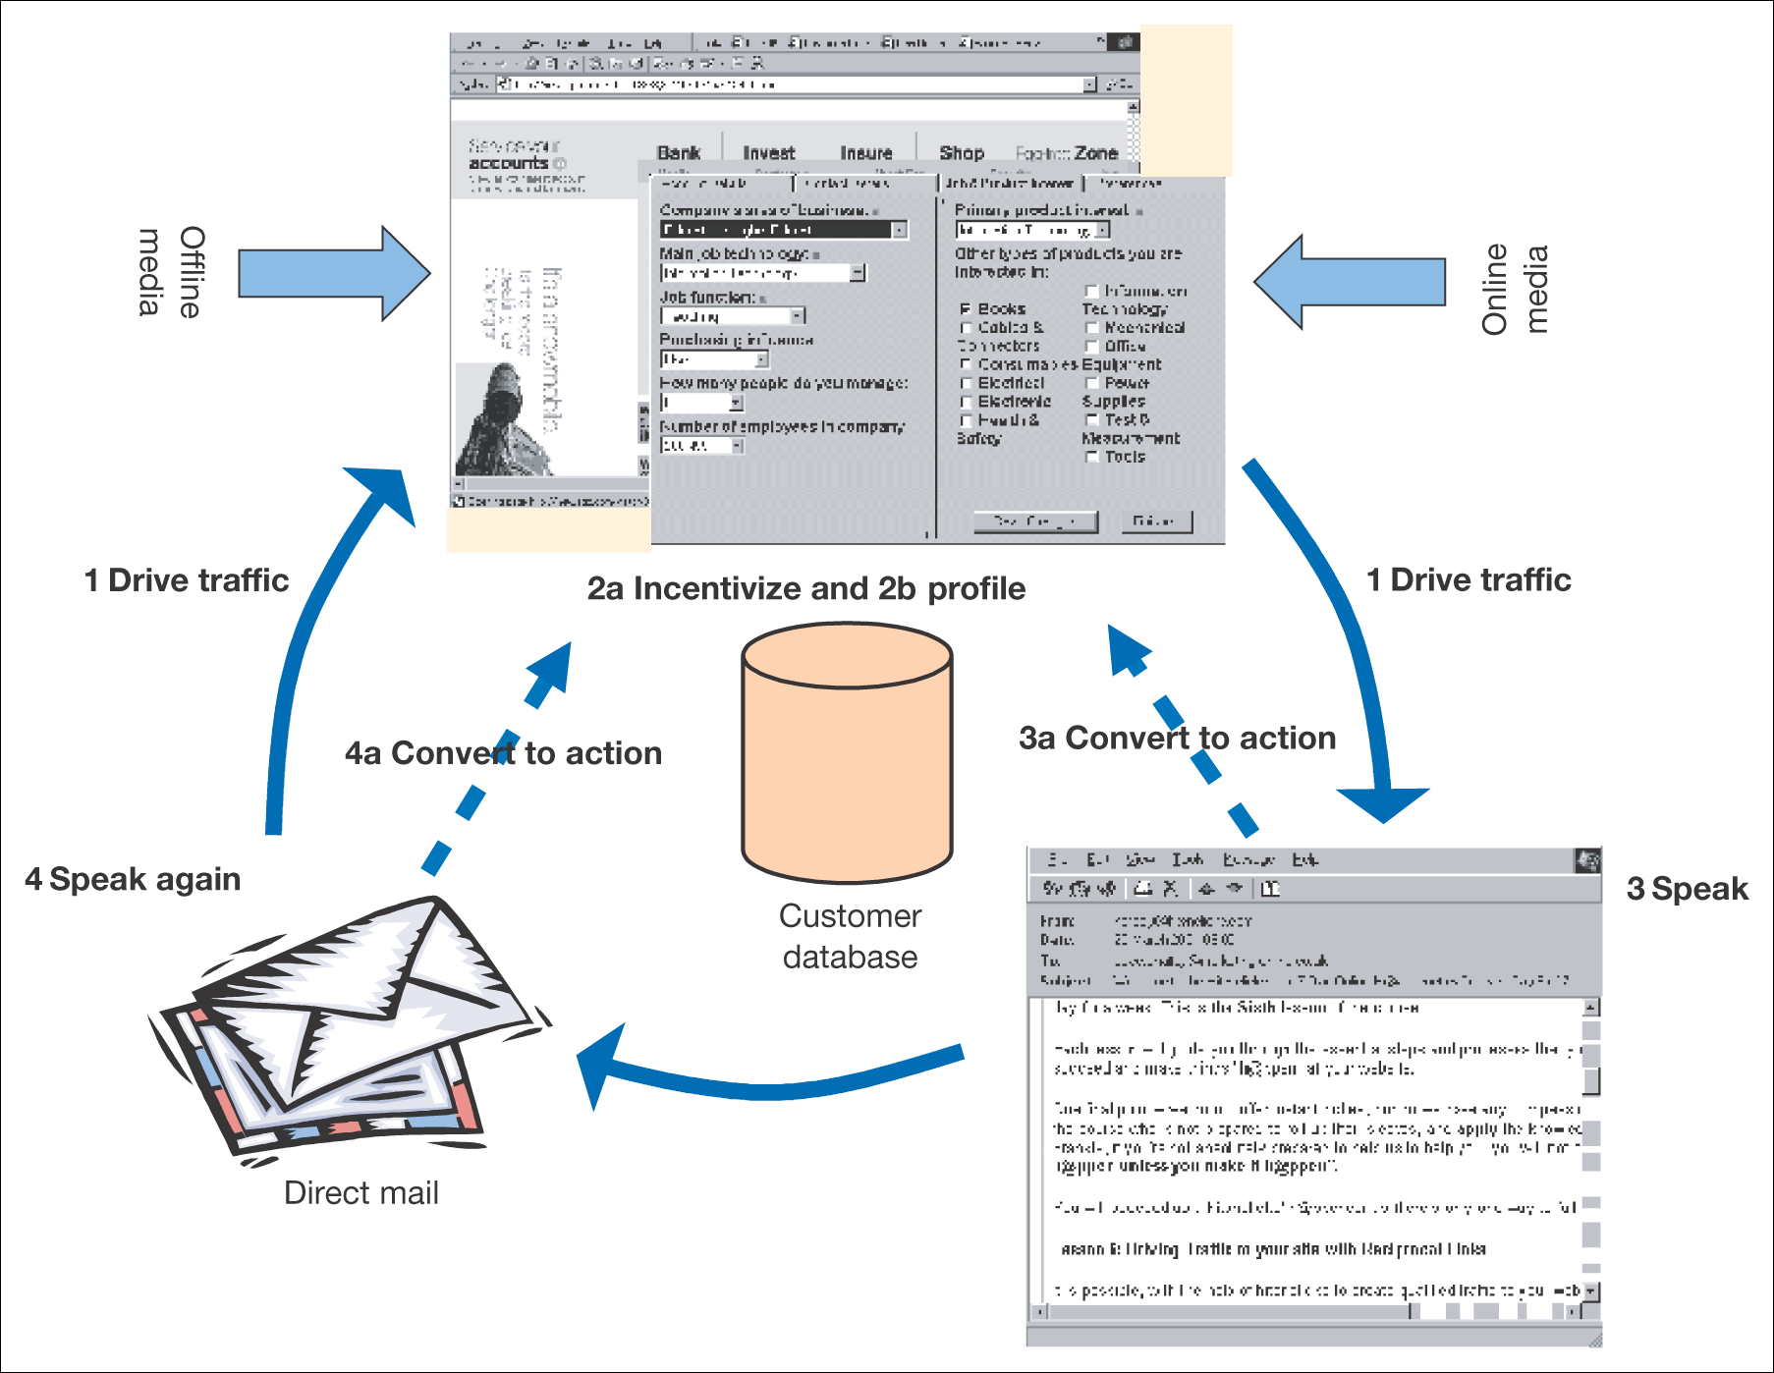
Figure 9.2 A summary of an effective process of online relationship building

Slide 11
Conversion Marketing
Using marketing communications to maximize conversion of potential customers to actual customers and existing customers to repeat customers
Agrawal et al. (2001) scorecard:
  Attraction
  Conversion
  Retention

Slide 12
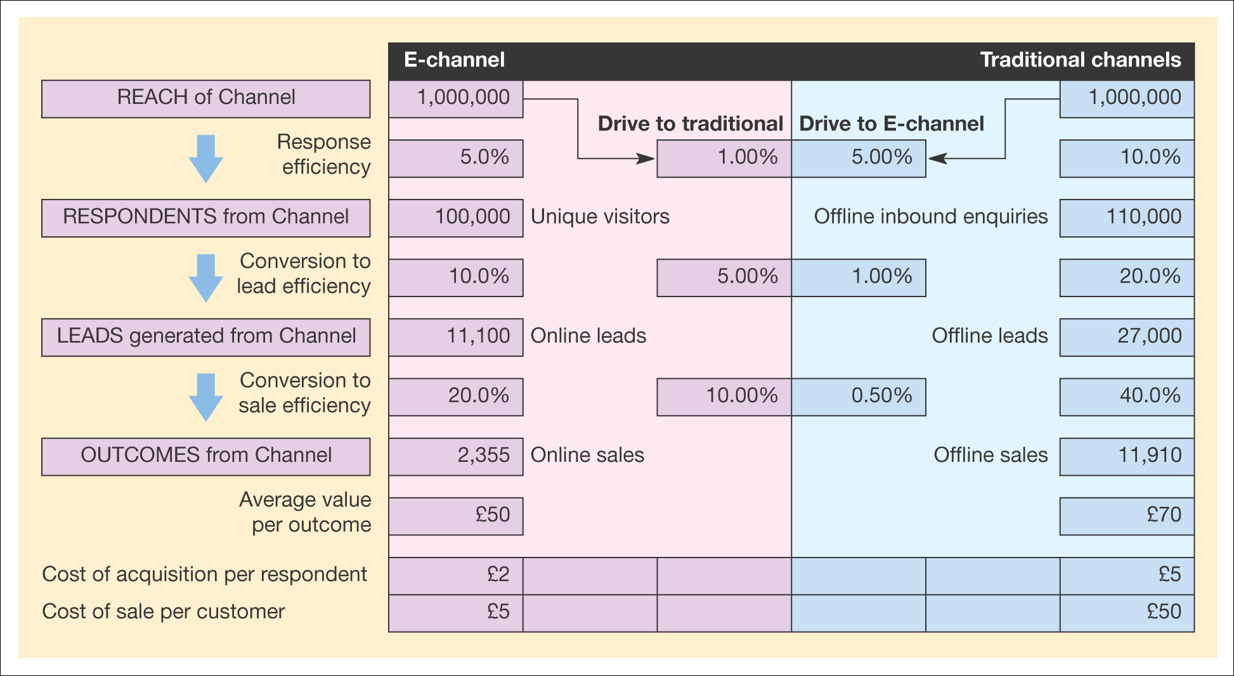
Figure 9.3 Multi-channel conversion model

Slide 13
The Online Buying Process
Five different types of web users
  Directed information-seekers
  Undirected information seekers
  Directed buyers
  Bargain hunters
  Entertainment seekers

Slide 14
Differences between B2B and B2C buyers
Market structure
Nature of the buying unit
Type of purchase
  Services: low-volume, high-value
  Stationary: high-volume, low-value

Slide 15
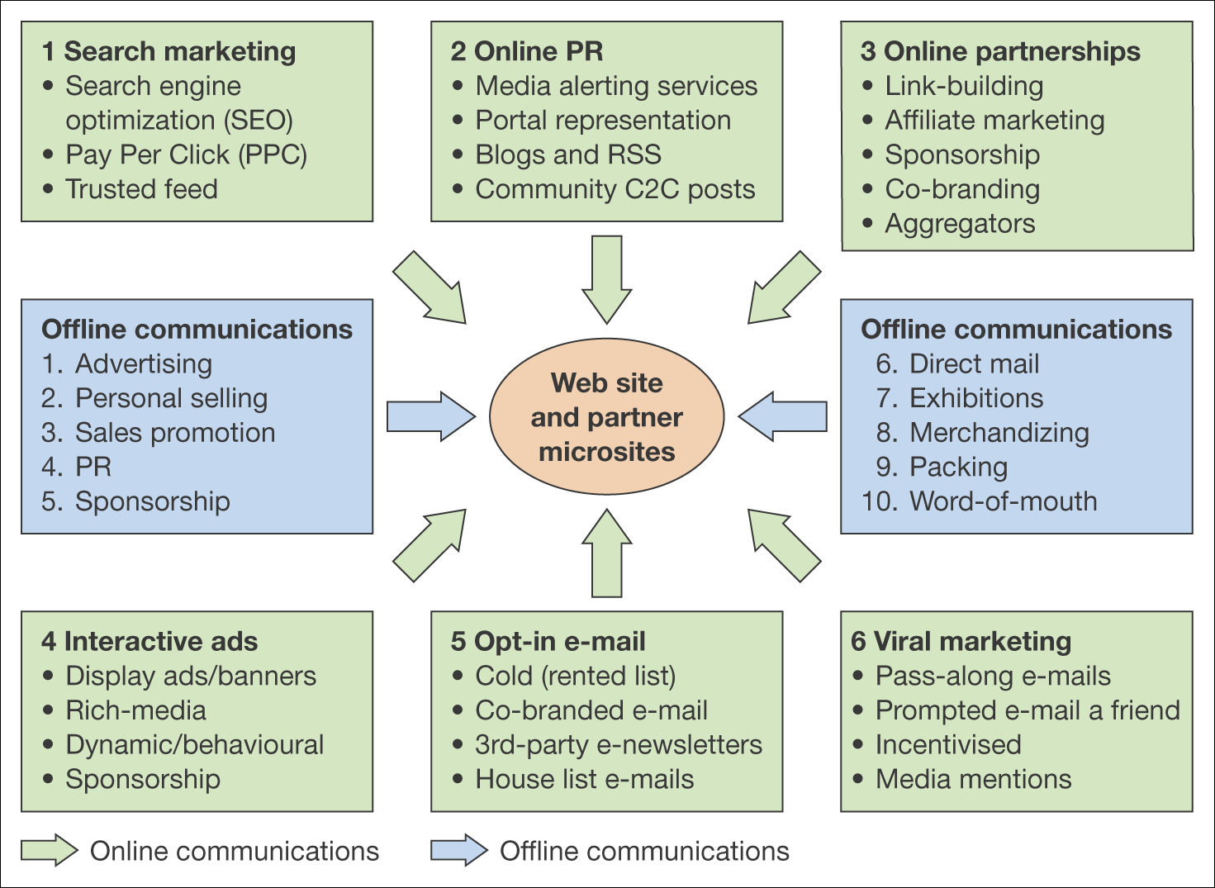
Figure 9.4 Online and offline communications techniques for e-commerce

Slide 16
Marketing Communications for Customer Acquisitions
From push to pull
From monologue to dialogue
From one-to-many to one-to-some
From one-to-many to many-to-many
From ‘lean-back’ to ‘lean-forward’
The medium changes
Increase in communication intermediaries
Integration remains important

Slide 17
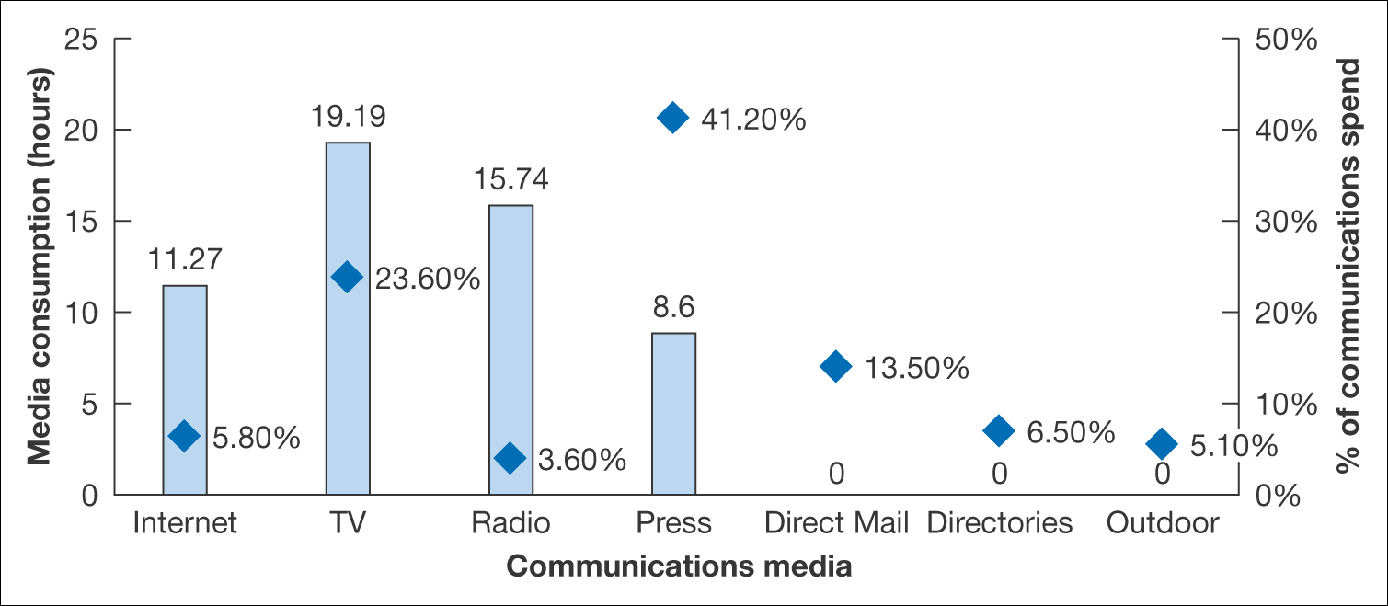
Figure 9.5 Variation in UK media consumption in hours (bars) compared to
percentage media expenditure (squares)
Source: Compiled from EIAA (2005) and IAB (2005)

Slide 18
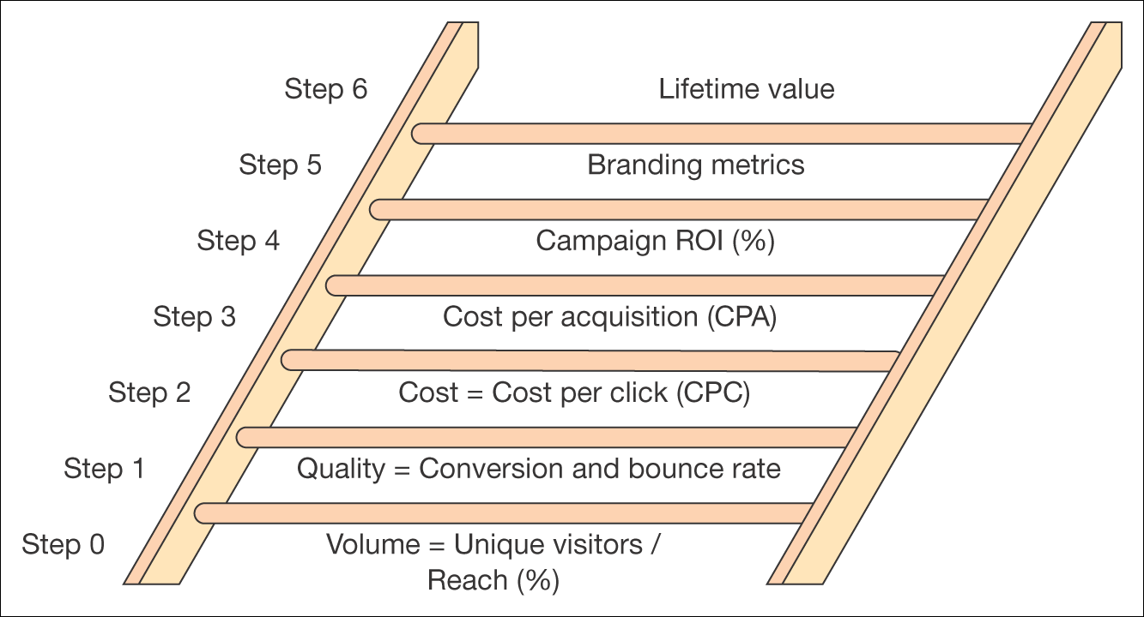
Figure 9.6 Measures used for setting campaign objectives or assessing campaign success increasing in sophistication from bottom to top

Slide 19
Assessing marketing communication effectiveness
0 Volume or number of visitors
1 Quality or conversion rates to action
2 Cost (cost per click)
3 Cost (cost per action or acquisition)
4 Return on investment
5 Branding metrics
6 Lifetime-value-based ROI

Slide 20
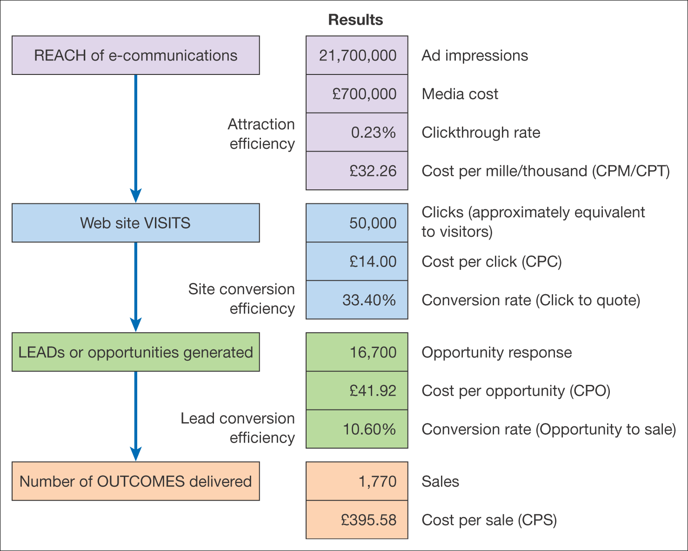
Figure 9.7 An example of effectiveness measures for an online ad campaign

Slide 21
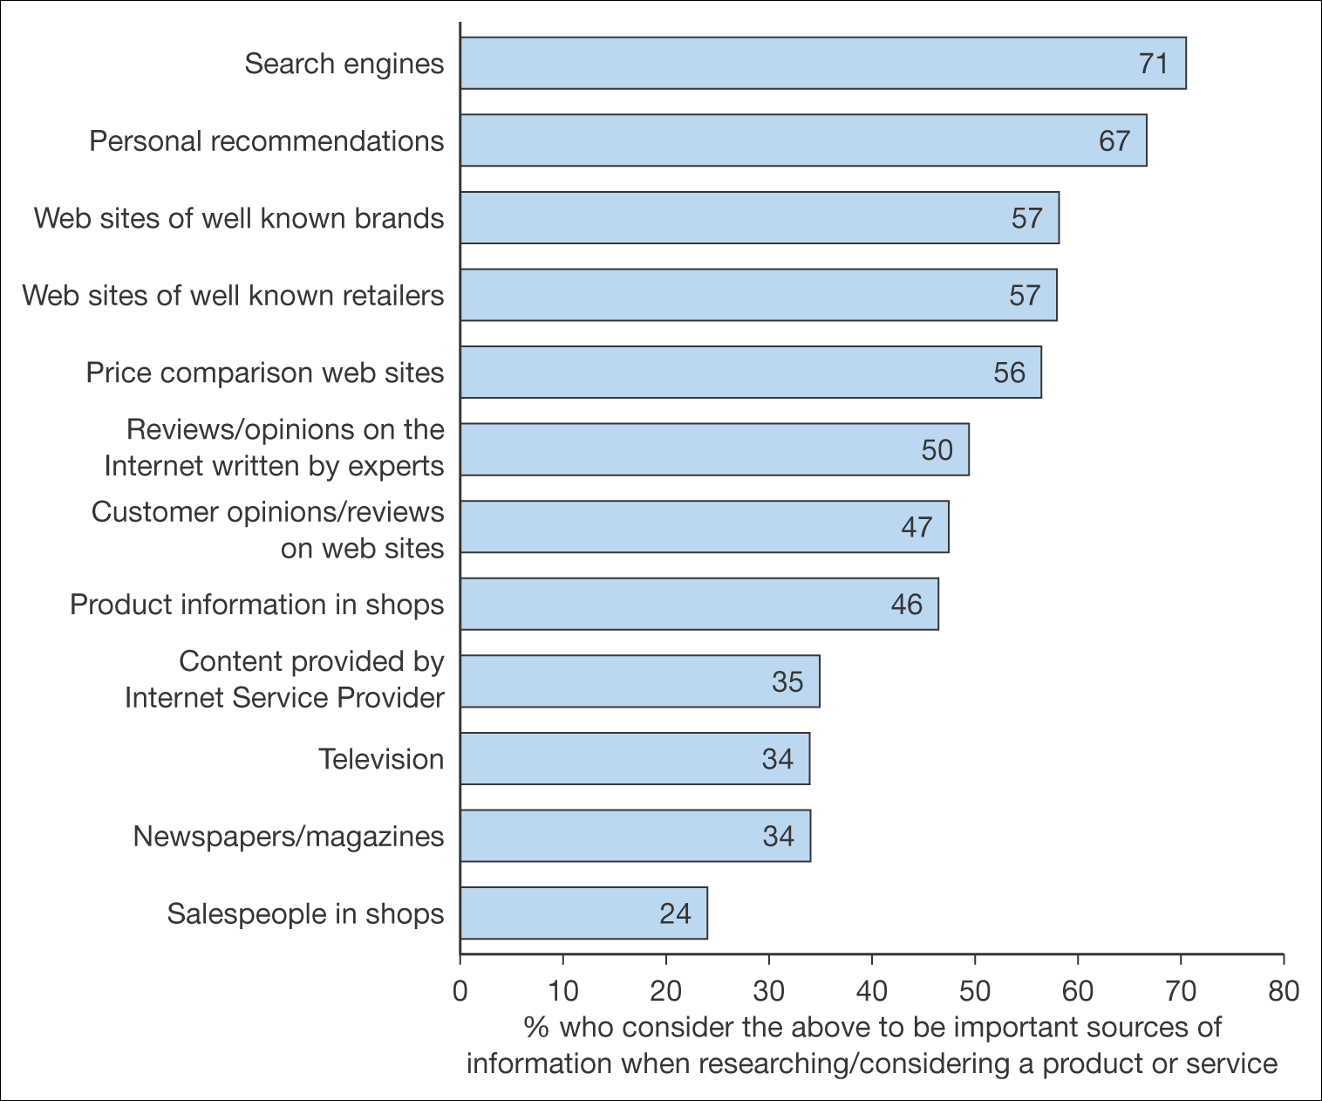
Figure 9.8 Percentage who consider the different information sources as important when researching/considering a product or service
Source: BrandNewWorld: AOL UK/Anne Molen (Cranfield School of Management)/Henley Centre, 2004

Slide 22
Online marketing communications
Search-engine marketing (SEM)
  Search-engine optimization
    Frequency of occurrence in body copy
    Number of inbound links
    Title HTML tag
    Meta-tag
  Paid search marketing
Online PR
  Communicating with media online
  Link building
  Blogs, podcasting and RSS
  Managing brand on third-party sides

Slide 23
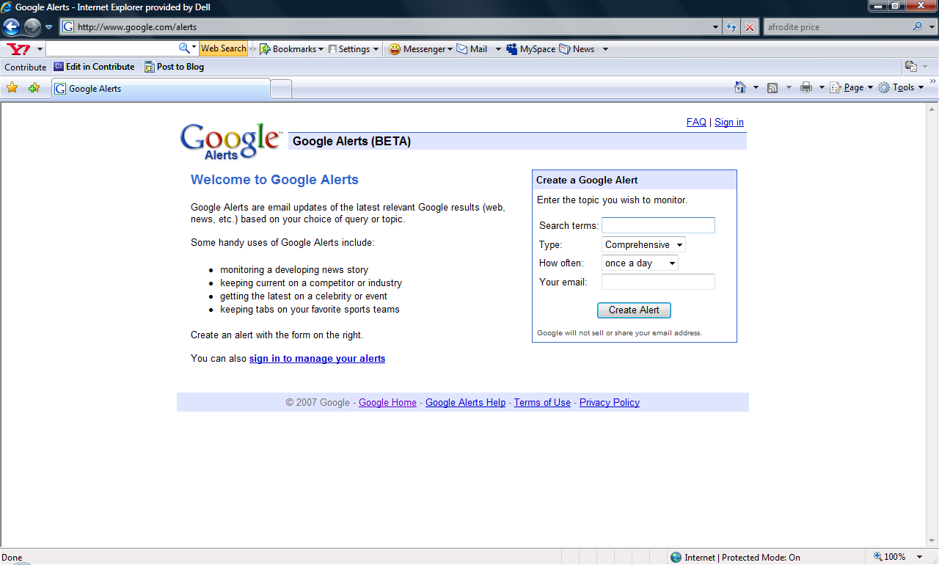
Google Alert

Slide 24
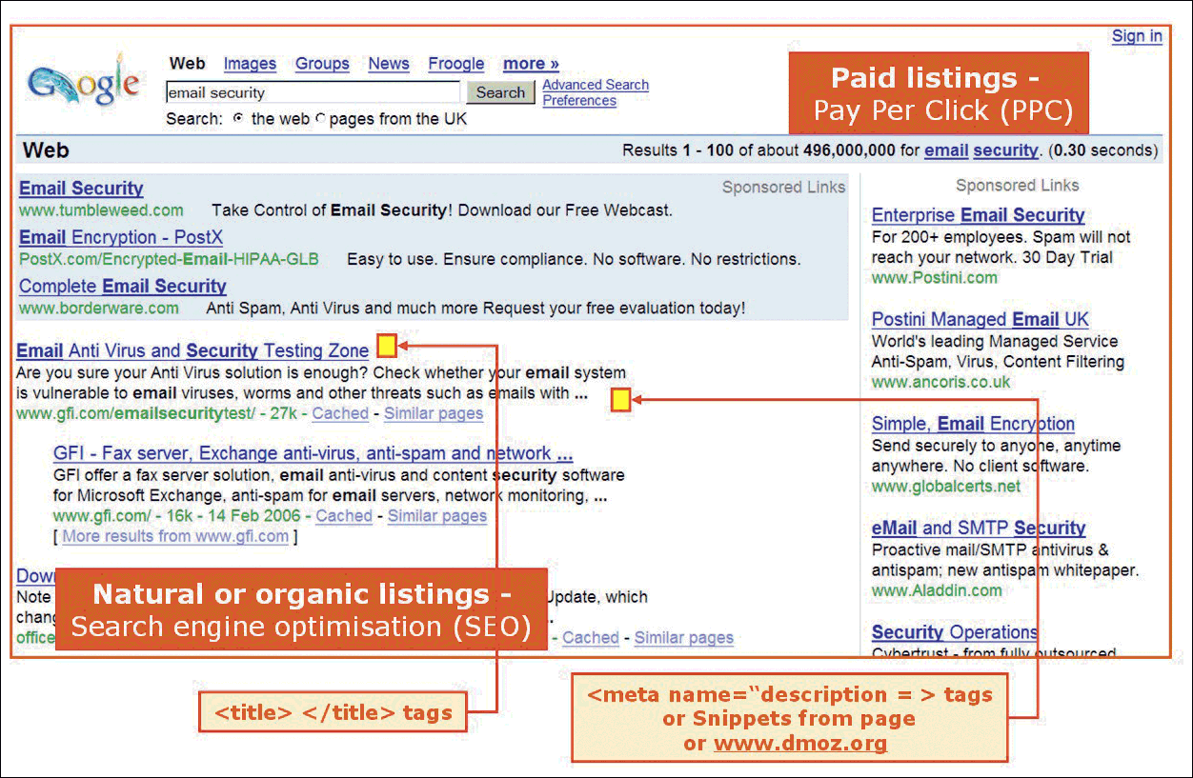
Figure 9.9 Search engine results page showing the two main methods for achieving visibility
Source: Screenshot reprinted by permission of Google, Inc

Slide 25
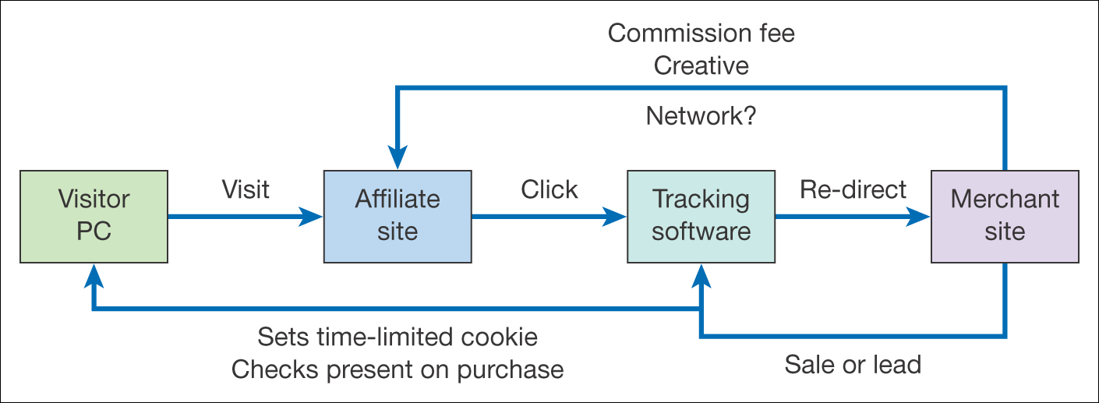
Figure 9.10 The affiliate marketing model
(note that the tracking software and fee payment may be managed through an independent affiliate network manager)

Slide 26
Online marketing communications
Online partnerships
  Affiliate marketing
  Online sponsorship
Interactive advertising
E-mail marketing
Viral marketing

Slide 27
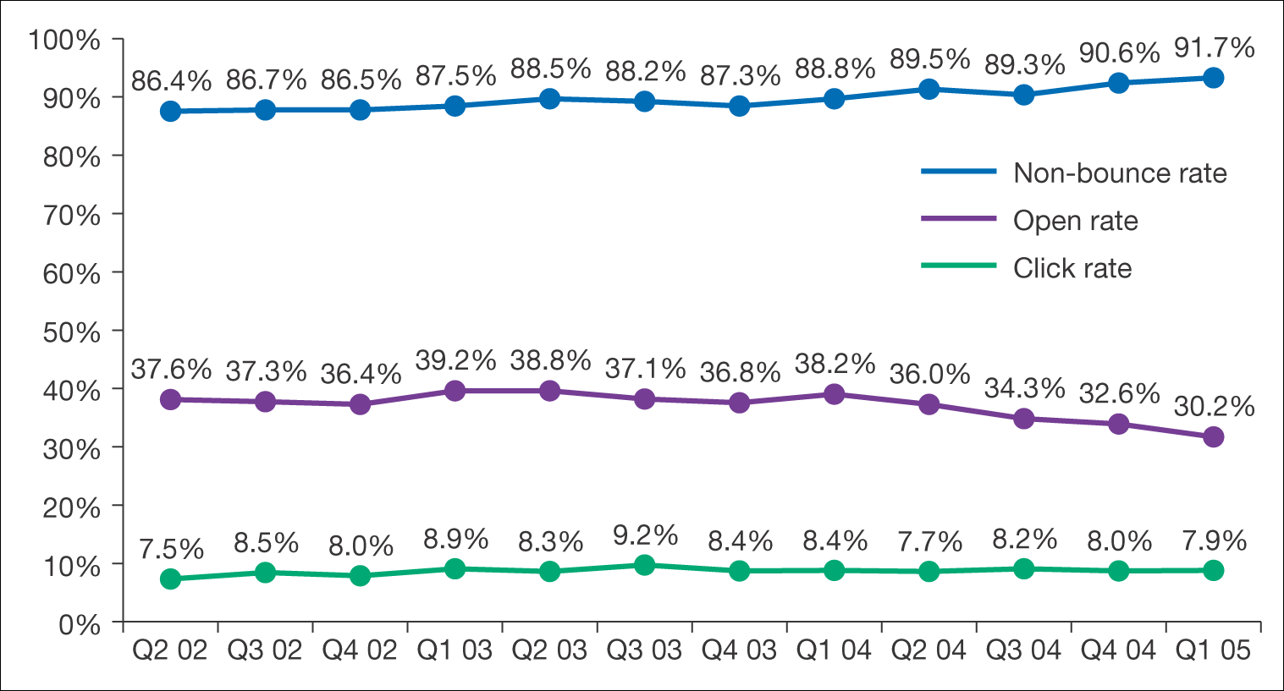
Figure 9.11 E-mail response figures
Source: Epsilon Interactive

Slide 28
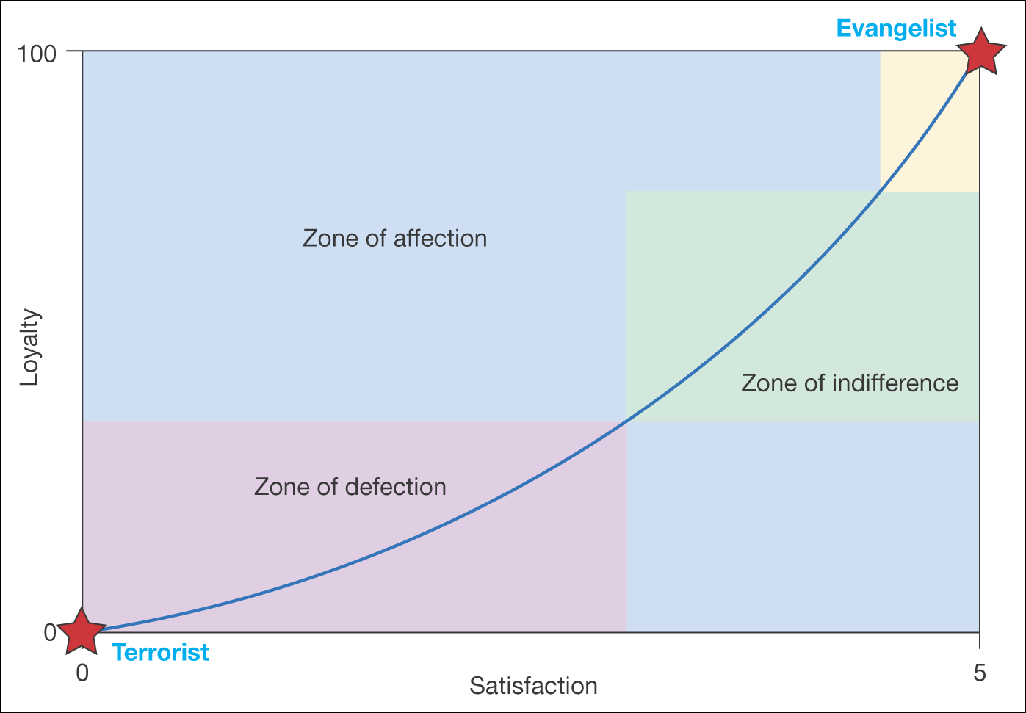
Figure 9.12 Schematic of the relationship between satisfaction and loyalty
Source: Adapted and reprinted by permission of Harvard Business Review from graph on p. 167 from ‘Putting the service-profit chain to work,’ by Heskett, J., Jones, T., Loveman, G., Sasser, W. and Schlesinger, E., in Harvard Business Review, March–April 1994. Copyright © 1994 by the Harvard Business School Publishing Corporation, all rights reserved

Slide 29
Customer retention management
Has two distinct goals
  To retain customers of the organization
  To keep customers using the online channel

Slide 30
Personalization
Creating personalization
Extranets
Opt-in e-mail

Slide 31
Online Communities
A customer-to-customer interaction delivered via e-mail groups, web-based discussion forums or chat
Choices of developing community for B2C
  Purpose
  Position
  Interest
  Profession

Slide 32
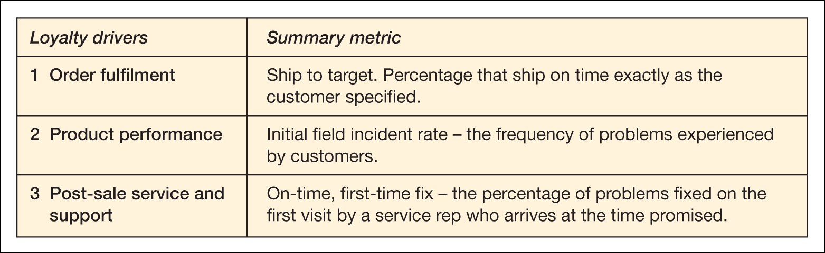
Table 9.4 Relationship between loyalty drivers and measures to assess their success at Dell Computer
Source: Reprinted by permission of Harvard Business Review from information on pp. 105–13 from ‘Your secret weapon on the web’, by Reicheld, F. and Schefter, P., in Harvard Business Review, July–August 2000. Copyright © 2000 by the Harvard Business School Publishing Corporation, all rights reserved

Slide 33
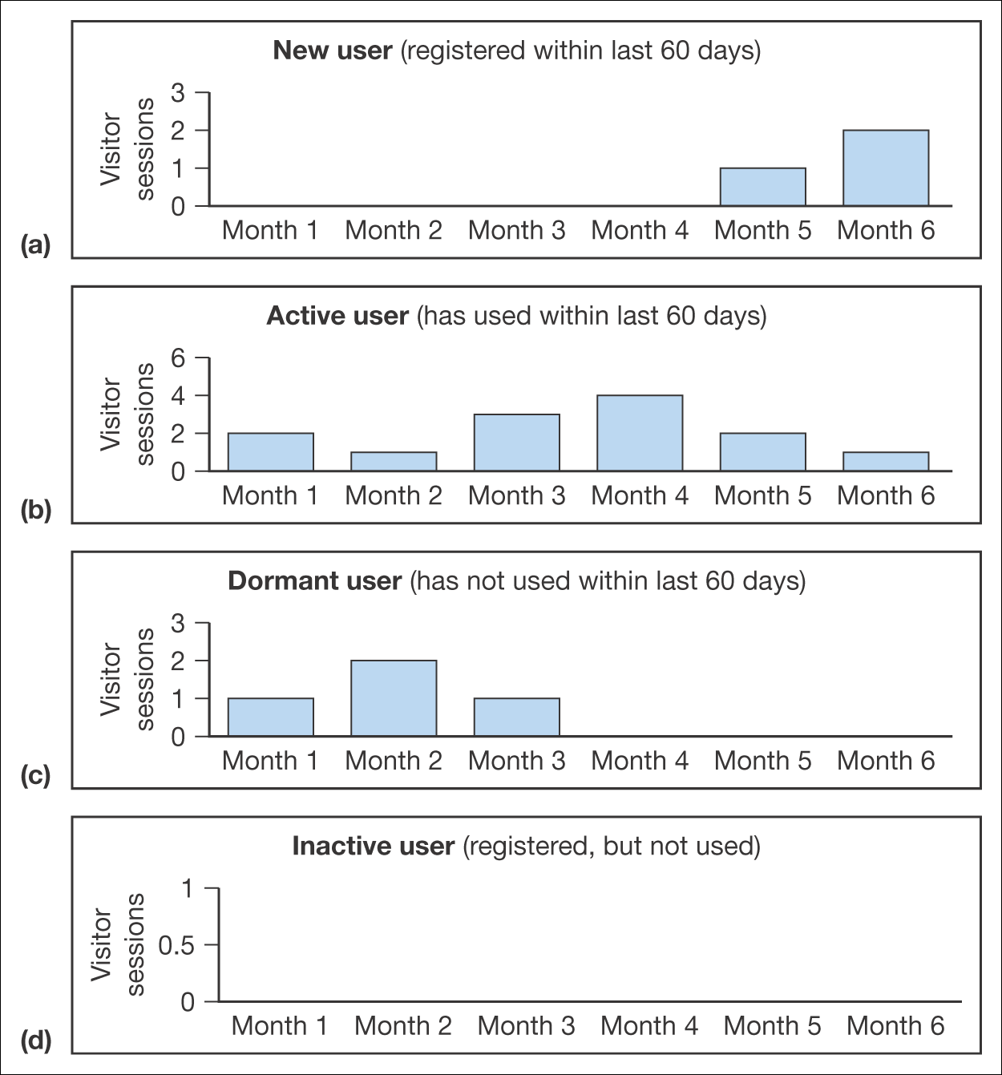
Figure 9.13 Activity segmentation of a site requiring registration

Slide 34
Lifetime value modeling
Lifetime value analysis enables marketers:
  Plan and measure investment
  Identify and compare critical target segments
  Measure the effectiveness
  Establish the true value
  Make decisions about products and offers
  Make decisions about the value of e-CRM

Slide 35
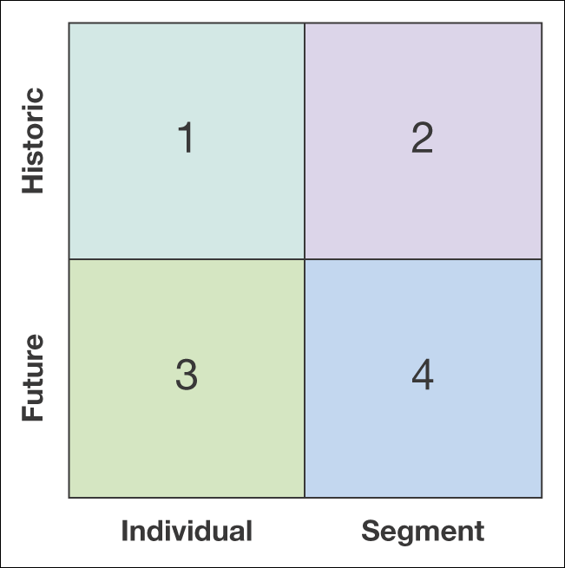
Figure 9.14 Different representations of lifetime value calculation

Slide 36
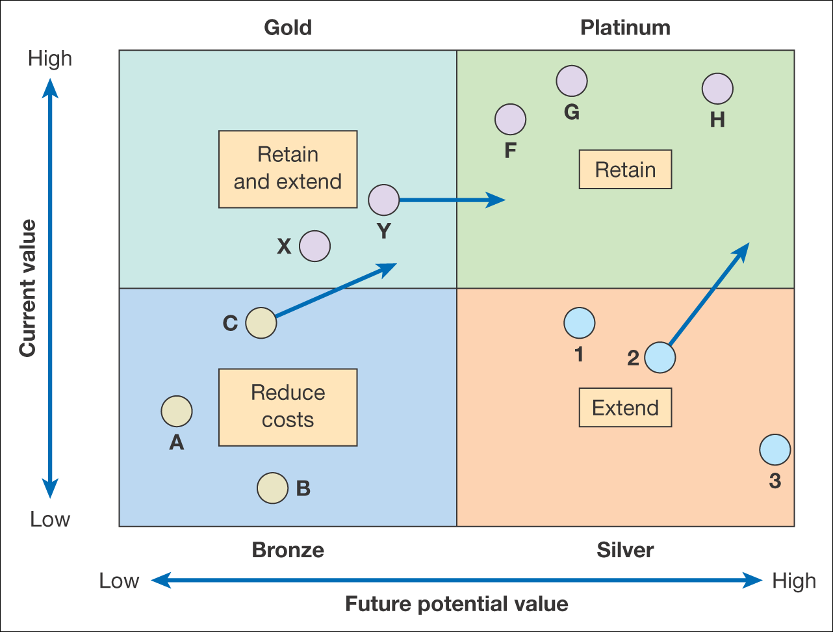
Figure 9.15 An example of an LTV-based segmentation plan

Slide 37
Customer extension
Deepening the relationship with the customer through increased interaction and product transactions

Slide 38
Advanced online segmentation
Identify customer lifecycle groups
Identify customer profile characteristics
Identify behavior in response and purchase
Identify multi-channel behavior
Tone and style preference

Slide 39
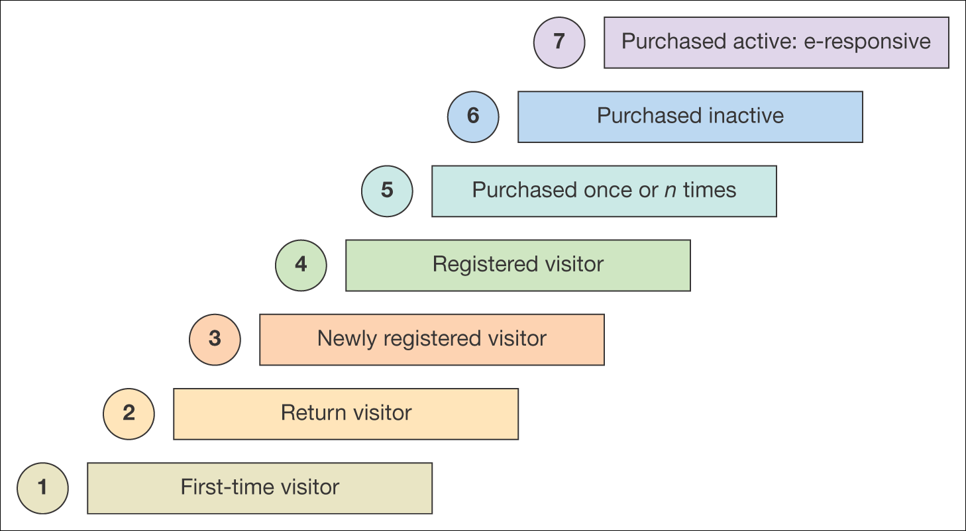
Figure 9.16 Customer lifecycle segmentation

Slide 40
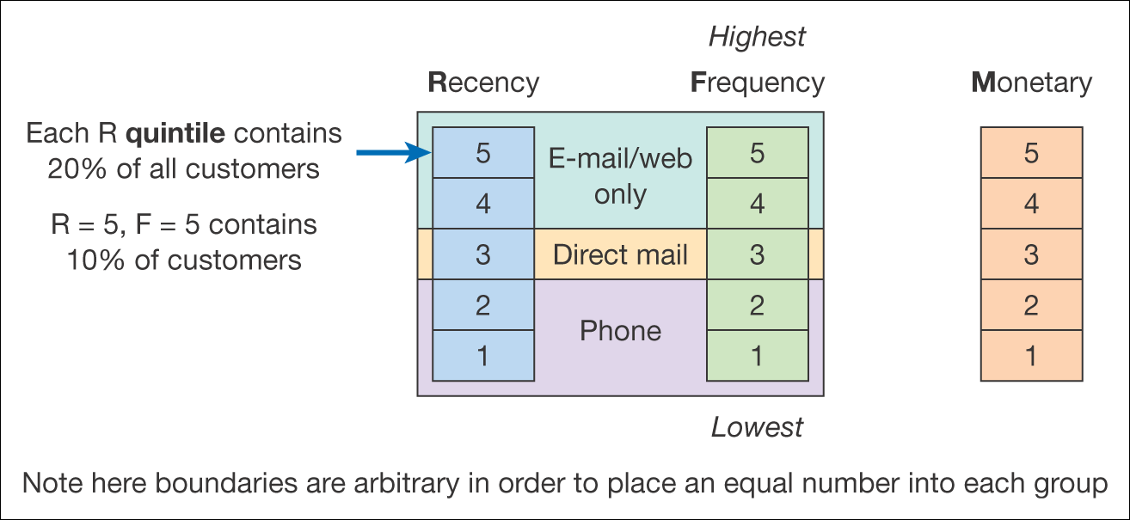
Figure 9.17 RFM analysis

Slide 41
Types of CRM applications
Ideal CRM system will support multi-channel communications or the customer preferred channel

Slide 42
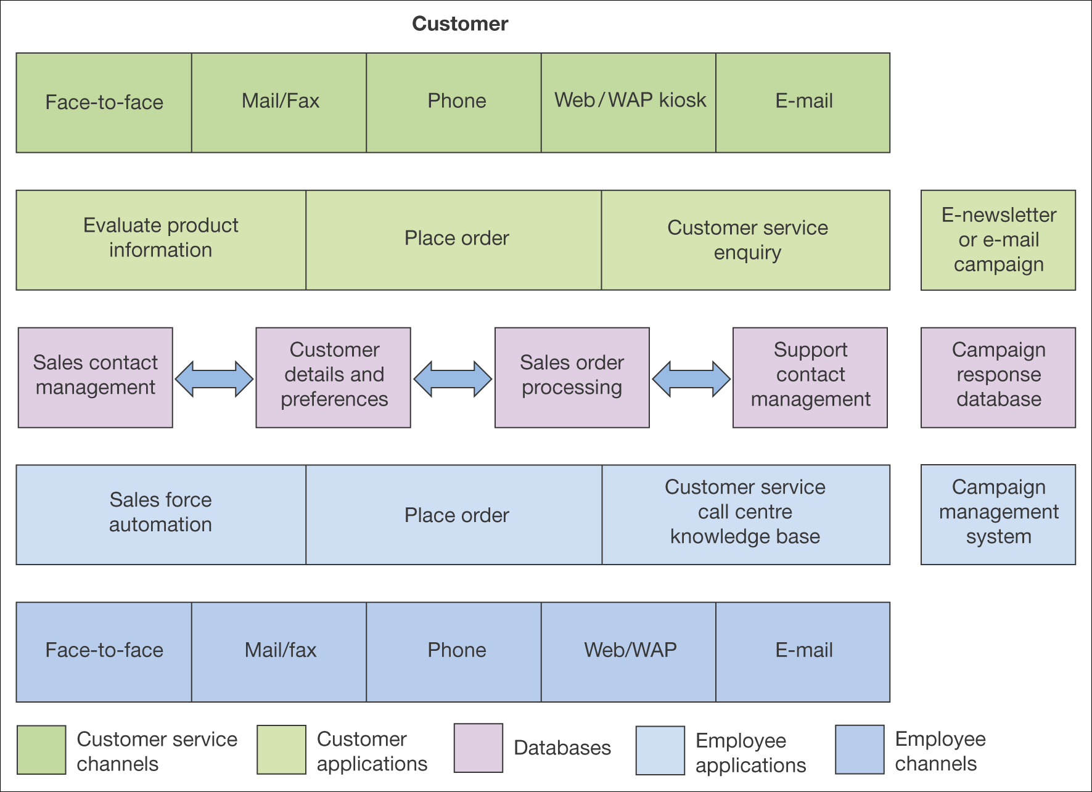
Figure 9.18 An overview of the components of CRM technologies

